Slide 1


History of Psychology
[Professor Name]
[Class and Section Number]
Notes:
Classroom Recommendations: This module was designed to be taught in two 75-minute class periods, although it could be covered more quickly depending on how many and what specific activities are used. For a more involved warm up activity, see the following slide.
Overview: This module provides an introduction and overview of the historical development of the science and practice of psychology in America. Ever-increasing specialization within the field often makes it difficult to discern the common roots from which the field of psychology has evolved. By exploring this shared past, students will be better able to understand how psychology has developed into the discipline we know today.
Technical Note: These slides may contain simple click animation so that you can focus students’ attention on a particular question, a selection of text, or an image and not have them be distracted by reading ahead. You can either preview the sequence of animation by going through the slides in slideshow view, visiting the animations tab, or reviewing the slide notes. In the notes you will see a cue - (Click) – that corresponds to each animation.
You may also find hyperlinks to outside videos at various places in the slides. These hyperlinks are embedded in text and indicated by color and in the notes section.

Slide 2
Today’s Learning Objectives
Describe the precursors to the establishment of the science of psychology.
Identify key individuals and events in the history of American psychology.
Describe the rise of professional psychology in America.
Develop a basic understanding of the processes of scientific development and change.
Recognize the role of women and people of color in the history of American psychology.
Notes:
This slide outlines the learning objectives of the module.

Slide 3

Warm Up
What would others fail to understand about you if they did not know your history?
Notes:
The purpose of this slide is to introduce a warm-up discussion question
Discussion Question:
What would others fail to understand about you if they did not know your history?
One of the more challenging aspects of teaching the history of psychology is trying to get students to understand its importance. Consider asking the students to take 3-5 minutes to write down what others would fail to understand about them if they did not know their history. Let the students know that they will not be forced to share this information with anyone but may share with the group if they would like to. Once students have completed writing or the time limit has been reached, engage the class in a group discussion about what they wrote down. The goal of this introductory activity is to get students to engage with their own personal histories in an effort to see how much of the richness of what makes them who they are has come from past experience – the good, bad, and ugly experiences alike.

Slide 4
Overview
Introduction and Prehistory
Physiology and Psychophysics
Scientific Psychology Comes to the U.S.
Toward a Functional Psychology
The Growth of Psychology
Applied Psychology in the U.S.
Psychology as a Profession
Psychology and Society
Notes:
The purpose of this slide is for the instructor to provide students with an overview of the material that will be covered during the lecture.

Slide 5
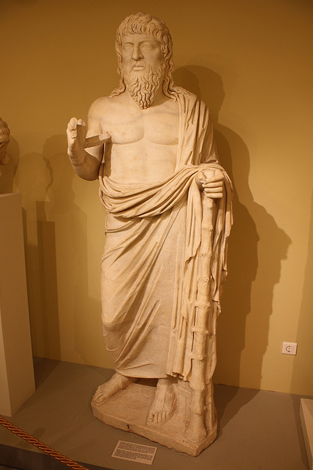
Introduction and Prehistory
Introduction
Importance of History
Prehistory
  Ancient Greeks
Notes:
The purpose of this slide is to introduce the importance of history in the development of the field of psychology.
(Click): Introduction
Importance of History
Prehistory
Now that students have connected on a more personal level with the importance of history, move through the introduction and prehistory sections.
(Click): Ancient Greeks
It’s especially important to emphasize that the majority of the history in this unit is from the mid-19th century on, and if they move on in psychology and one day take a History and Systems of Psychology course, it will like likely start in ancient Greece.
For more information on the influence of Ancient Greek philosophy on psychology, please check out the resources below:
http://www.sonoma.edu/users/d/daniels/greeks.html
https://www.psychologytoday.com/blog/turning-straw-gold/201406/surprisingly-modern-wisdom-ancient-greeks-and-romans

Slide 6

Empiricism
John Locke (1632-1704) and Thomas Reid (1710-1796) emphasized empiricism, or the primacy of the senses in acquiring knowledge.
Notes:
This slide introduces students to philosophers such as John Locke (1632–1704) and Thomas Reid (1710–1796) who promoted empiricism, the idea that all knowledge comes from experience. The work of Locke, Reid, and others emphasized the role of the human observer and the primacy of the senses in defining how the mind comes to acquire knowledge.
Discussion Questions:
Can we trust our senses?
Students may disagree in their answers: Some may point out that the senses are trustworthy channels for observing the world. Others might point out small sensory fallacies: mishearing what another person says, seeing movement in your peripheral vision when it was really just a shadow, etc. The main point of this prompt is to illustrate the virtues and limits of sensory observation; especially in light of the fact that observation forms the basis of scientific inquiry.
Should we rely more on logic and rational thought (rationalism) or sensory and perceptual data (empiricism) when acquiring knowledge?
Again, students may disagree in their answers: There are many “ways of knowing” including faith, reason and empiricism. Traditionally, philosophers relied on logic and argumentation to present internally coherent theories. Logic and rational thought are limited, however, as they are poor tools for understanding counter-intuitive phenomena.

Slide 7
Overview
Introduction and Prehistory
Physiology and Psychophysics
Scientific Psychology Comes to the U.S.
Toward a Functional Psychology
The Growth of Psychology
Applied Psychology in the U.S.
Psychology as a Profession
Psychology and Society
Notes:
The purpose of this slide is for the instructor to indicate to the students that the lecture is moving forward to the next content topic.

Slide 8

Physiology and Psychophysics
Is perception reality?
Notes:
The purpose of this slide is to introduce the concepts of physiology and psychophysics in a psychological context
Consider asking the follow question as the students are looking at the triangle: Is perception reality? This discussion can be a great set-up for von Helmholtz’s findings (and Locke’s before him) that our senses can, and sometimes do, deceive us.
Note on the image: This is an image of what’s known as a Penrose Triangle or an impossible object – it depicts an example of the effects of human brain on the perception of an object.

Slide 9

Physiology and Psychophysics
Hermann von Helmholtz
  Speed of the neural impulse
  Senses are fallible but can still be studied
Gustav and Fechner
  Measured relationships between experience of senses and external reality (psychophysics)
Notes:
The purpose of this slide is to continue discussion on physiology and psychophysics.
(Click): Hermann von Helmholtz
This slide begins with Hermann von Helmholtz’s explorations of the sensory systems that can be discussed here.
(Click): Speed of the neural impulse
His work focuses on measuring the speed of the neural impulse as well as his inquires into the physiology of hearing and vision.
(Click): Senses are fallible but can still be studied
In part, his work demonstrated that our senses were fallible but could still be studied scientifically.
(Click): Gustav and Fechner
German researchers Ernst Weber and Gustav Fechner investigated the concept of psychophysics, or the relationship between the experiences of the senses and external reality.
(Click): Measured relationships between experience of senses and external reality (psychophysics)
Weber and Fechner discovered ways to measure physical stimuli and the human perception of said stimuli.

Slide 10

Physiology and Psychophysics
Brain and Mind
Notes:
This slide is a Brain and Mind Activity
For this activity ask students to hold out their right hands and extend their right index fingers. Once all of the students have done this ask them to reach out and touch their brains (or at least the area where their brain is even if they can’t actually touch their cerebral cortex, which I hope they can’t!). Once sufficient time has been given for all students to complete this, then ask them to reach out with the same finger and touch their minds. You will notice that students respond in a variety of ways (some still touch their heads, some touch their hearts, some look at you hopelessly befuddled, etc.). You can then note that the brain is a three-pound organ that we can locate in the body and thus tangibly study while the mind is something intangible. Although some modern neuroscientists argue that brain and mind are one in the same, there is far from universal agreement on this. Emphasize the challenge that Wundt and Titchner were taking on in studying the mind. This can be an engaging way to get students interested in Wundt’s introspection and study of consciousness.

Slide 11

Physiology and Psychophysics
Wilhelm Wundt (1832-1920)
  “Father of Psychology”
  Focused on introspection or identifying elements of consciousness scientifically
Notes:
This slide continues to discuss physiology and psychophysics and focuses on Wilhelm Wundt
(Click): Wilhelm Wundt (1832-1920)
(Click): Father of Psychology
This slide discusses Wilhelm Wundt is widely considered to be the “father of psychology,” even though he was actually a physiologist and philosopher. Wundt helped to establish and promote the field of experimental psychology. He was a consummate teacher and academic and exposed countless students to the field.
(Click): Focused on introspection or identifying elements of consciousness scientifically
Wundt’s work focused largely on introspection, the goal of which was to identify elements of consciousness. Perhaps his most famous work was completed in the area of reaction time. The research of Wundt and his students showed that consciousness could be studied in a scientific fashion.

Slide 12
Overview
Introduction and Prehistory
Physiology and Psychophysics
Scientific Psychology Comes to the U.S.
Toward a Functional Psychology
The Growth of Psychology
Applied Psychology in the U.S.
Psychology as a Profession
Psychology and Society
Notes:
The purpose of this slide is for the instructor to indicate to the students that the lecture is moving forward to the next content topic.

Slide 13
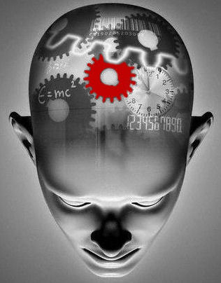
Scientific Psych Comes to the U.S.
Psychology Comes to the U.S.
  Wundt’s relationship to Titchener and structuralism (studying contents of the mind)
  Rapid spread of experimental psychology
  Balance of science and practice
Notes:
The purpose of this slide is to discuss the advent of scientific psychology to the U.S.
(Click): Psychology comes to the U.S.
(Click): Wundt’s relationship to Titchener and structuralism (studying the contents of the mind)
This slide focuses on Edward Titchner, a student of Wundt’s, who brought some of Wundt’s ideas to the U.S. Titchener’s work was referred to as structuralism and this work was interested in the contents of the mind and what the mind is.
(Click): Rapid spread of experimental psychology
Experimental psychology spread quickly in North America with over 40 labs in the U.S. and Canada by 1900. Feeling that the American Psychological Association (APA) did not adequately represent the interests of experimental psychologists, Titchner spearheaded the creation of the Society of Experimental Psychologists. One of Titchener’s students, Margaret Floy Washburn, became the first woman in America to earn a Ph.D. in psychology.
(Click): Balance of science and practice
Striking a balance between the science and practice of psychology continues to this day. In 1988, the American Psychological Society (now known as the Association for Psychological Science) was founded with the central mission of advancing psychological science.

Slide 14
Overview
Introduction and Prehistory
Physiology and Psychophysics
Scientific Psychology Comes to the U.S.
Toward a Functional Psychology
The Growth of Psychology
Applied Psychology in the U.S.
Psychology as a Profession
Psychology and Society
Notes:
The purpose of this slide is for the instructor to indicate to the students that the lecture is moving forward to the next content topic.

Slide 15

Toward a Functional Psychology
Functionalism (what the mind does) emerged as an alternative to structuralism (how mind is structured)
Notes:
The purpose of this slide is to begin a discussion on functionalism
Functionalism (what the mind does) emerged as an alternative to structuralism (how mind is structured).
Helping students distinguish between structuralism and functionalism is a crucial objective on this slide. Sometimes words mean exactly what students would assume by reading them, and indeed, that is the case here with structuralism focusing on the structure or composition of the mind and functionalism focusing on how the mind functions or what it does. Once students have a basic understanding of functionalism now the stage is set to discuss the work of William James, G. Stanley Hall, and James McKeen Cattell as laid out on this slide and the ones to follow.
Functionalism emerged as an alternative approach to structuralism. This movement was pushed forward by the likes of William James, G. Stanley Hall, and James McKeen Cattell and focused on what the mind does as opposed to the structuralist focus of what it is and what it is composed of. Functionalism opened the door for comparative psychology.
.

Slide 16
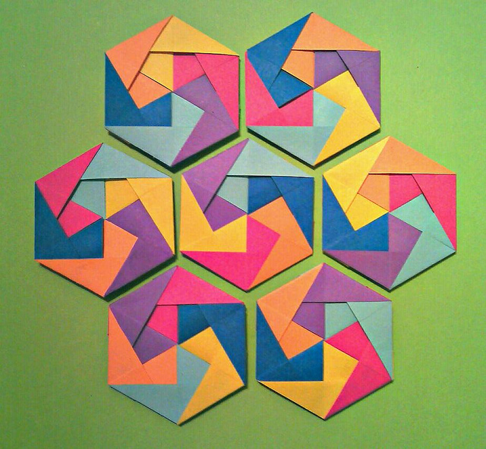
Toward a Functional Psychology
William James’ (1842-1910) seminal book Principles of Psychology asserted consciousness should be studied as a continuous whole
Notes:
The purpose of this slide is to discuss William James and his contribution to functionalism.
William James’ (1842-1910) seminal book Principles of Psychology asserted consciousness should be studied as a continuous whole
William James’ book, Principles of Psychology, is widely regarded as one of the most important ever written in psychology. In it, James proposed that consciousness was not something that could be studied by breaking it down into its component parts. Instead, it must be studied as an ongoing and continuous whole. Once of James’ students, Mary Whiton Calkins, went on to become the first woman to serve as president of the APA.

Slide 17

Toward a Functional Psychology
G. Stanley Hall (1844-1924) founded the first American journal of psychology and the first lab in the U.S.
  Much of his work focused on child development and education
Notes:
The purpose of this slide to discuss G. Stanley Hall and his contribution to functionalism.
(Click): G. Stanley Hall (1844-1924) founded the first American journal of psychology and the first lab in the U.S.
This slide emphasizes that G. Stanley Hall founded the American Journal of Psychology, which was the first American journal of psychology. He also founded the first psychology lab in America in 1883 at Johns Hopkins University.
(Click): Much of his work focused on child development and education
Much of Hall’s work focused on child development and education. Hall mentored Francis Cecil Sumner who became the first African American to earn a Ph.D. in psychology in the U.S. in 1920.

Slide 18

Toward a Functional Psychology
James McKeen Cattell (1860-1944) spent his career looking at individual differences and the idea that intelligence was inherited and could be measured.
Many of his ideas were aligned with the eugenics movement (selective breeding).
Notes:
The purpose of this slide is to discuss James McKeen Cattell and his contribution to functional psychology.
James McKeen Cattell spent much of his career looking at individual differences, most specifically the idea that intelligence was inherited and could be measured. His beliefs about identifying and promoting society’s most intelligent were akin to those in the eugenics movement (selective breeding). Cattell’s work sparked much debate about the contributions of genetics and environment in intelligence.

Slide 19
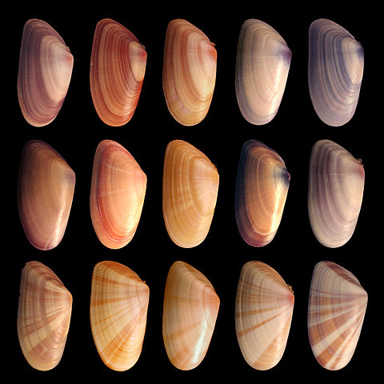
Toward a Functional Psychology
How do these seashells illustrate individual differences?
Notes:
The purpose of this slide is to discuss a concept of individual differences
Discussion Question:
How do these seashells illustrate individual differences?
This image helps to illustrate what individual differences might look like within the same species. While all the shells are of the same species, they are not all exactly the same.

Slide 20
Overview
Introduction and Prehistory
Physiology and Psychophysics
Scientific Psychology Comes to the U.S.
Toward a Functional Psychology
The Growth of Psychology
Applied Psychology in the U.S.
Psychology as a Profession
Psychology and Society
Notes:
The purpose of this slide is for the instructor to indicate to the students that the lecture is moving forward to the next content topic.

Slide 21

The Growth of Psychology
Psychology’s growth was prodigious in the first half of the 20th century incorporating many points of view
Gestalt psychology was a great example of this expansion
Notes:
This slide emphasizes that psychology’s growth remained prodigious throughout the first half of the 20th century accommodating various points of view.
(Click): Psychology’s growth was prodigious in the first half of the 20th century incorporating many points of view
(Click): Gestalt psychology was a great example of this expansion
Gestalt psychology, famous for the idea that the whole is greater than the sum of its parts, is a notable example. The Gestalt movement proposed that the mind processed multiple stimuli simultaneously as opposed to doing so sequentially. Gestalt ideas are often seen as a precursor to the cognitive psychology revolution that took place later in the 20th century.

Slide 22

The Growth of Psychology
Gestalt psychology emphasizes the idea that the whole is greater than the sum of its parts.
How does this picture embody that statement?
Notes:
The purpose of this slide is to continue the discussion on gestalt psychology
Discussion Question:
Gestalt psychology emphasizes the idea that the whole is greater than the sum of its parts. How does this picture bring embody that statement?
The image on this slide depicts a lot of rocks that at some point chipped off of a bigger rock and now are parts of the whole. The idea of Gestalt psychology is the idea that the whole is greater than the sum of its parts and this picture depicts “parts” or “pieces” of the whole.

Slide 23
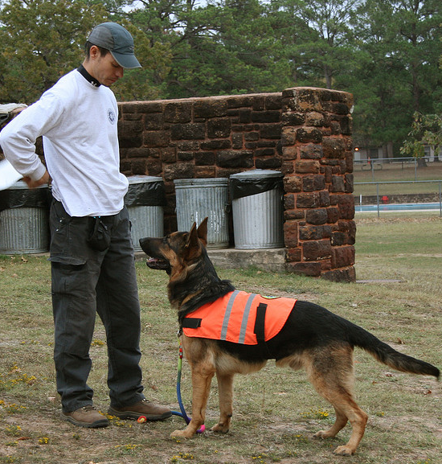
The Growth of Psychology
Behaviorists like B.F. Skinner (1904-1990) and John Watson (1878-1958) focused on what was observable and measurable
Ultimate goal was prediction and control of behavior
Notes:
The purpose of the introduce the concept of behaviorism
(Click): Behaviorists like B.F. Skinner (1904-1990) and John Watson (1878-1958) focused on what was observable and measurable
The behaviorist movement, championed by psychologists like B.F. Skinner and John Watson, focused on that which was observable and measurable, thereby rejecting the idea that the mind could be studied.
(Click): Ultimate goal was prediction and control of behavior
The ultimate goal was prediction and control of behavior. Classical conditioning, made famous by Ivan Pavlov, was another behavioral idea that lent credence to the notion that learning and behavior could be studied without the mind or consciousness.
If you would like more information on Classical Conditioning, please refer to the Conditioning and Learning Noba Module which can be found at: http://noba.to/ajxhcqdr

Slide 24

The Growth of Psychology
In the 1960’s cognitive psychologists posited that mental processes such as language, memory, and problem solving should play a larger role in understanding human behavior
Notes:
This slide emphasizes that is wasn’t until the 1960’s in America that behaviorism began to lose some of its momentum and people began challenging the idea that a model that neglected mental processes could fully explain human behavior. This ushered in the era of cognitive psychology, where special attention was paid to language and memory yielding research on flashbulb memory, the tip-of-the-tongue phenomenon, and working memory.

Slide 25

CAT: The Muddiest Point
What was the muddiest point about today’s class?
Write down what concept you are still struggling to understand.
Notes:
Classroom Assessment Technique (CAT): The Muddiest Point
Ask students to write down the “muddiest point” – that is any concept they are still struggling to understand of any questions they still may have about the material. Collect and review their responses and use the next slide to ask students to share their muddiest point and provide additional review on these points.
This slide is the conclusion of first class period.
If you do not conclude with this Classroom Assessment Technique (CAT), it would helpful to use another CAT. It could be in the form of a:
Muddy point
One-minute paper
Background knowledge
What’s the Principle?
Defining features Matrix:
For more information on CATs click here: http://cft.vanderbilt.edu/guides-sub-pages/cats/

Slide 26
CAT: The Muddiest Point
  Last class you were asked to write down a quick response to the following question: What was the muddiest or most confusing point in today’s class period?
  Would anyone like to share? Perhaps we can provide some clarity before moving on to today’s topics.
Notes:
This slide marks the beginning of the second class period.
The Muddiest Point is one of the simplest CATs to help assess where students are having difficulties. The technique consists of asking students to jot down a quick response to one question: “What was the muddiest point in [the lecture, discussion, homework assignment, film, etc.]?” The term “muddiest” means “most unclear” or “most confusing.”

Slide 27
Overview
Introduction and Prehistory
Physiology and Psychophysics
Scientific Psychology Comes to the U.S.
Toward a Functional Psychology
The Growth of Psychology
Applied Psychology in the U.S.
Psychology as a Profession
Psychology and Society
Notes:
The purpose of this slide is for the instructor to indicate to the students that the lecture is moving forward to the next content topic.

Slide 28

Applied Psychology in the U.S.
Is Intelligence Quotient or IQ the same thing as intelligence? Why or why not?
Notes:
You can start this slide by asking students if Intelligence Quotient (IQ) is the same thing as intelligence. Engaging them in a discussion about how IQ is a social construct designed to approximate intelligence can often prove fruitful. Additionally, it can be helpful to remind students that intelligence is a hypothetical, abstract concept. For example, one’s intelligence cannot be determined from drawing one’s blood and analyzing it. Once these ideas are wrestled with, students will now be positioned to better understand the work of Binet, Terman, and Munsterberg as the section progresses.

Slide 29

Applied Psychology in the U.S.
French psychologist Alfred Binet (1857-1911) developed intelligence tests that helped identify children in need of educational support
Most of his tests involved reasoning and problem-solving tasks
Notes:
The purpose of this slide is to discuss the contributions of Alfred Binet to psychology
(Click): French psychologist Alfred Binet (1857-1911) developed intelligence tests that helped identify children in need of educational support
This slide discusses how French psychologist Alfred Binet helped to develop intelligence tests that were useful in identifying schoolchildren in need of educational support.
(Click): Most of his tests involved reasoning and problem-solving tasks
His test focused mostly on reasoning and problem solving tasks.
For more information on Alfred Binet and intelligence testing, please refer to the Intelligence Noba Module which can be found at: http://noba.to/ncb2h79v

Slide 30
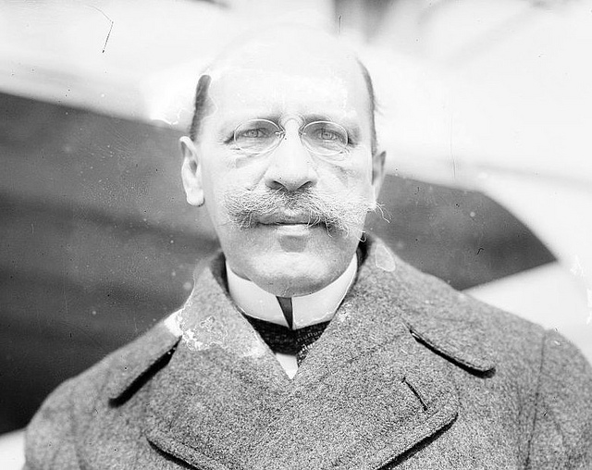
Applied Psychology in the U.S.
Hugo Munsterberg (1863-1916) was a pioneer in Industrial/Organizational (I/O) psychology.
  His research on employee selection was especially significant.
Notes:
The purpose of this slide is to discuss Hugo Munsterberg and his contribution to psychology
(Click): Hugo Munsterberg (1863-1916) was a pioneer in Industrial/Organizational (I/O) psychology.
(Click): His research on employee selection was especially significant.
This slide notes that Hugo Munsterberg was a pioneer in what is now referred to as industrial organizational psychology with his research on employee selection. He also completed research on eyewitness testimony and psychotherapy.
For more information on IO Psychology please refer to the Industrial Organizational Psychology Noba Module which can be found at: http://noba.to/qe3m9485, for more information on Hugo Munsterberg, please see: http://faculty.frostburg.edu/mbradley/psyography/hugomunsterberg.html

Slide 31
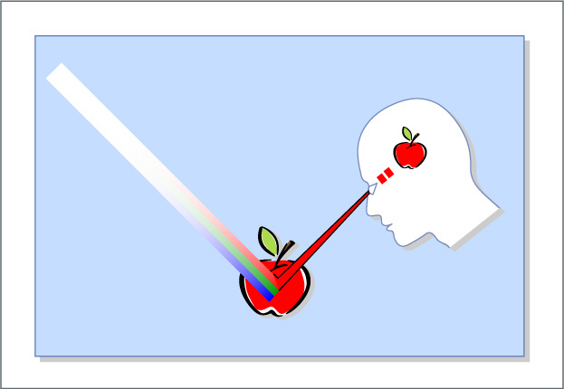
Applied Psychology in the U.S.
Lightner Witmer (1867-1956) was a clinical psychologist who created the first clinical psychology journal and the first clinic in the U.S.
Notes:
This slide summarizes the important contributions of Lightner Witmer.
Lightner Witmer (1867–1956) received his Ph.D. in experimental psychology with Wilhelm Wundt and returned to the University of Pennsylvania, where he opened a psychological clinic in 1896. Witmer believed that because psychology dealt with the study of sensation and perception, it should be of value in treating children with learning and behavioral problems. He is credited as the founder of both clinical and school psychology.

Slide 32
Overview
Introduction and Prehistory
Physiology and Psychophysics
Scientific Psychology Comes to the U.S.
Toward a Functional Psychology
The Growth of Psychology
Applied Psychology in the U.S.
Psychology as a Profession
Psychology and Society
Notes:
The purpose of this slide is for the instructor to indicate to the students that the lecture is moving forward to the next content topic.

Slide 33
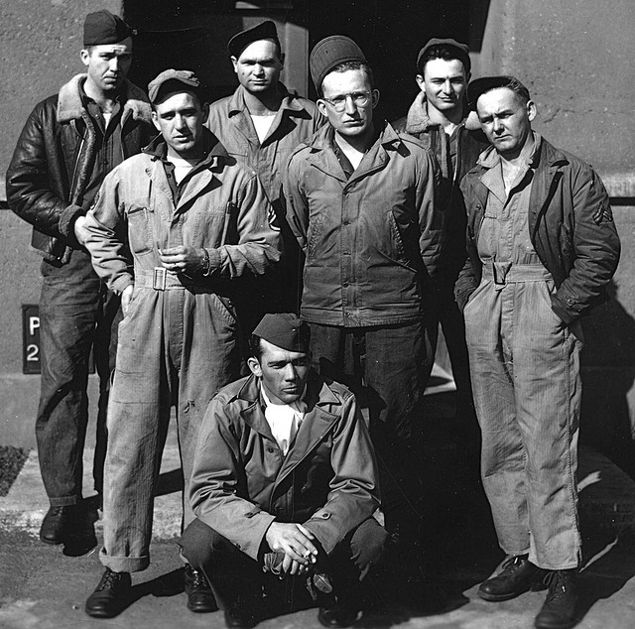
Psychology as a Profession
In 1930 the American Association for Applied Psychologists (AAAP) was formed
The National Mental Health Act of 1946 created funding to train clinical psychologists
These developments allowed for treatment of veterans returning home from WW II
Notes:
This slide focuses on psychology as a profession.
(Click): In 1930 the American Association for Applied Psychologists (AAAP) was formed
As the roles of psychologists and the needs of the public continued to change, it was necessary for psychology to begin to define itself as a profession. Without standards for training and practice, anyone could use the title psychologist and offer services to the public. As early as 1917, applied psychologists organized to create standards for education, training, and licensure. By the 1930s, these efforts led to the creation of the American Association for Applied Psychology (AAAP). While the American Psychological Association (APA) represented the interests of academic psychologists, AAAP served those in education, industry, consulting, and clinical work.
(Click): The National Mental Health Act of 1946 created funding to train clinical psychologists
The advent of WWII changed everything. The psychiatric casualties of war were staggering, and there were simply not enough mental health professionals to meet the need. Recognizing the shortage, the federal government urged the AAAP and APA to work together to meet the mental health needs of the nation. The result was the merging of the AAAP and the APA and a focus on the training of professional psychologists. Through the provisions of National Mental Health Act of 1946, funding was made available that allowed the APA, the Veterans Administration, and the Public Health Service to work together to develop training programs that would produce clinical psychologists.
(Click): These developments allowed for treatment of veterans returning home from World War II
For more information on the types of treatment that were received by the US veterans returning home, please visit: http://www.ncbi.nlm.nih.gov/pmc/articles/PMC2089086/

Slide 34
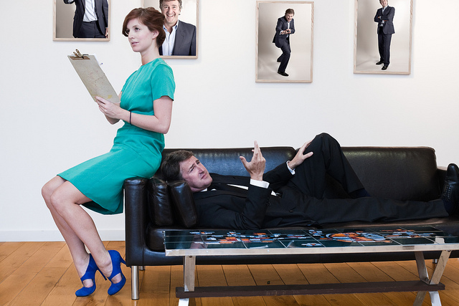
Psychology as a Profession
    The scientist-practitioner or Boulder model was formalized in 1949 and emphasizes both practice and research video
    The scholar-practitioner or Vail model was created in 1973 and emphasizes clinical training practice over research video
Notes:
The purpose of the this slide is to help students understand the Boulder and Vail models.
(Click): The scientist-practitioner or Boulder model was formalized in 1949 and emphasizes both practice and research
The Boulder Conference on Graduate Education in Clinical Psychology in 1949 in Boulder, Colorado launched doctoral training in psychology and gave us the scientist-practitioner model of training. Similar meetings also helped launch doctoral training programs in counseling and school psychology.
(Click): The scholar-practitioner or Vail model was created in 1973 and emphasizes clinical training practice over research
Throughout the second half of the 20th century, alternatives to Boulder have been debated. In 1973, the Vail Conference on Professional Training in Psychology proposed the scholar-practitioner model and the Psy.D. degree (Doctor of Psychology). It is a training model that emphasizes clinical training and practice that has become more common (Cautin & Baker, in press).
It might prove helpful to show links to websites for graduate schools from each of the aforementioned training models so that students can see some of the differences.
Example webpage for scientist practitioner: http://psych.colorado.edu/~clinical/
Example webpage for scholar-practitioner: http://www.du.edu/gspp/programs/psyd-clinical/
Showing students modern graduate program websites will help them better appreciate just how important the events discussed in this section were, and continue to be.
Reference:
Cautin, R., & Baker, D. B. (in press). A history of education and training in professional psychology. In B. Johnson & N. Kaslow (Eds.), Oxford handbook of education and training in professional psychology. New York, NY: Oxford University Press.

Slide 35
Overview
Introduction and Prehistory
Physiology and Psychophysics
Scientific Psychology Comes to the U.S.
Toward a Functional Psychology
The Growth of Psychology
Applied Psychology in the U.S.
Psychology as a Profession
Psychology and Society
Notes:
The purpose of this slide is for the instructor to indicate to the students that the lecture is moving forward to the next content topic.

Slide 36

Psychology and Society
Psychologists have used science to impact social change
In 1936 the Society for the Psychological Study of Social Issues (SPSSI) was formed
Notes:
The purpose of this slide is to discuss the impact of psychology on society.
(Click): Psychologists have used science to impact social change
Historically, psychologists have used science to challenge stereotypes, stigma, and other ideas that society might take for granted.
(Click): In 1936 the Society for the Psychological Study of Social Issues (SPSSI) was formed
In 1936 the Society for the Psychological Study of Social Issues (SPSSI) was formed and helped support research on myriad of social issues some of which are discussed on the next slide.

Slide 37
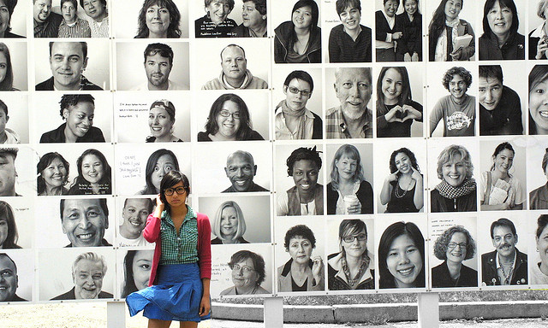
Psychology and Society
Leta S. Hollingworth: Research on stereotypes
Kenneth and Mamie Phipps Clark: Research on segregation
Evelyn Hooker: Research on sexual orientation
Notes:
This slide continues the discussion of psychology and society
(Click): Leta S. Hollingworth: Disproved stereotypical beliefs about women and emotion
In the early 20th century, Leta S. Hollingworth challenged the idea that women were overemotional in comparison to men and found that menstruation did not negatively impact women’s abilities on the job.
(Click): Kenneth and Mamie Phipps Clark: Research on how segregation negatively impacts self-esteem in African American kids
The work of African American psychologists Mamie Phipps Clark and her Husband Kenneth Clark helped to show how segregation negatively impacts the self-esteem of African American children. This research was of chief importance in the famous 1954 Brown v. Board of Education ruling that ended school segregation.
(Click): Evelyn Hooker: Challenged ideas about sexual orientation and psychological adjustment
Evelyn Hooker’s 1957 paper helped to challenge stereotypes of sexual orientation as it demonstrated no significant differences in psychological adjustment between homosexual and heterosexual men.

Slide 38

Who Should We Hire?
Instructions
Get into groups of 5.
You will receive 3 names
Each of these 3 is a finalist for a job of a psychology professor
You will have 10-15 minutes to discuss the merits of each candidate.
When time is up your group must decide whom to hire
Write no more than 500 words justifying their decision
Notes:
This slide proposes an activity called: “Hiring William James”
In the first activity, students are asked to be part of “search committee” to hire a new professor.
Directions for Instructors:
Instructors are to choose three historical figures covered in the module who will be competing for a job. One of the candidates does not necessarily have to be William James. This was just the title of the original activity as written in the journal Teaching of Psychology. It is suggested that the instructor choose three historical figures who they spent the most time with or who students found most interesting during the presentation of the module. Instructors can write a script outlining the job qualifications for each candidate or they can simply ask the students to seek out this information on their own in the module and through other outside sources.
Time: Approximately 30 minutes
Materials: Paper or a computer for the students to compose their collective written decision.
Source: Zehr, D. (2004). Two active learning exercises for a history of psychology class. Teaching of Psychology, 31(2), 54-56. doi:10.1207/s15328023top3101_10
Directions for Students:
(Click): Get into groups of 5.
Students should be divided into small groups of 3 or 5. Make sure it is an odd number so there cannot be a tie in the voting that is to come.
(Click): You will receive the names of 3 historical figures discussed in this module.
(Click): Each of these 3 is a finalist for a job as a psychology professor at this university.
Students are given three names of historical figures discussed in the module and told that these people are finalists for a faculty position at the university the students are attending.
(Click): You will have 10-15 minutes to discuss the merits of each candidate
Give students 10-15 minutes to discuss the merits of each and tell them once the time has concluded they must arrive at a decision of who to hire and a justification for the hire. It does not have to unanimous and democracy rules!
(Click): When time is up your group must make a recommendation of who to hire?
Once the time is up you must collectively decide which of the candidates you are going to hire.
(Click): Collectively write no more than 500 words justifying your hiring decision
Once time has expired, have the group collectively write no more than 500 words justifying the choice they made.

Slide 39
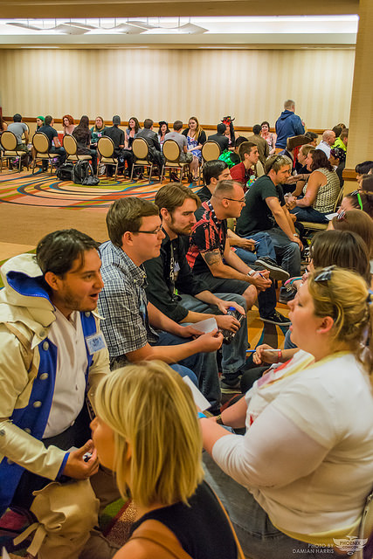
Speed-Dating
Receive a notecard with a historical figure name
Prepare a short bio
Spend 2 min talking with another student
Rotate
Write a reflection
Notes:
This slide presents an activity called: “Speed-Dating”
Time: Approximately 30 minutes
Materials: A pen and notecards
Source: Zehr, D. (2004). Two active learning exercises for a history of psychology class. Teaching of Psychology, 31, 54-56. doi:10.1207/s15328023top3101_10
Instructions for Students:
(Click): Each student will receive a notecard with the name of an historical figure discussed in the chapter
(Click): Prepare a short bio about the person on the card you receive
(Click): In a speed dating format, spend two minutes exchanging info with other students and then rotate
(Click): The activity concludes when every each student has spoken with every other student
(Click): Now, write a reflection on who (other than the person you were assigned) made the most important contribution to psychology’s history
Directions for Instructors:
This exercise can be done as a large group if the class is relatively small or in multiple groups if the class is large.
Gather the names of each of the major historical figures discussed in the module and put one name on each notecard. You will have to create multiple sets of notecards if you have a large class and will be dividing the class into groups.
Each student in the group is then given a single notecard with the name of one of the historical figures discussed in class.
Each student then prepares a short bio about the person to whom they were assigned.
Now, in a speed-dating format, students spend two minutes exchanging information with one another and then rotate. The end result is that every student eventually talks to every other student thereby exposing them to all of the major people covered in class.
The activity concludes by having each student write a brief reflection on who they thought made the most important contribution to the history of psychology, excluding the character they were assigned.

Slide 40

Toasting The Greats
Pick one historical figure that you really identified with
Write a short toast (no more than two minutes)
Be specific in your toast
Who wants to share?
Notes:
This slide presents an activity called: Toasting the Greats
While this activity was originally designed for higher-level History and Systems courses with a focus on lesser-known historical figures, it can easily be tweaked for an introductory course. In fact, almost all of the people discussed in this module are lesser-known figures to the typical introductory psychology student!
Time: Approximately 15 minutes
Materials: A pen and paper
Source: Wight, R. D. (1993). Expanding the coverage in the history course by toasting significant but often overlooked contributors. Teaching of Psychology, 20, 112. doi:10.1207/s15328023top2002_12
Instructions for Students:
(Click): Pick one historical figure and his or her ideas that you really identified with during the course of this module
(Click): Write a short toast (no more than two minutes) to the chosen person
(Click): Be specific in your toast so that it is clear why specifically you are honoring this person.
(Click): Who wants to share?
Directions for Instructors:
Ask each student to pick one person and his or her ideas that they really identified with during the course of this module.
Next, have them write a short toast (less than 2 minutes) as if they were honoring the person they chose at a formal dinner or banquet.
Remind students to be specific in their toasts such that there is a good understanding as to why they are honoring this person and their ideas. If there is time, students can actually write these in class. Students can also be assigned this in between classes and bring it with them to the next class meeting.
The activity concludes by having students share their toasts. This can be done with the larger class (for willing students) or in small groups.

Slide 41
CAT: The One-Minute Paper
What was the most important thing you learned during this class?
What important question remains unanswered?
Notes:
Classroom Assessment Technique (CAT): One-Minute Paper
The Minute Paper tests how students are gaining knowledge, or not. The instructor ends class by asking students to write a brief response to the following questions: “What was the most important thing you learned during this class?” and “What important question remains unanswered?”
Have students briefly answer these questions in writing and turn them in. After class, assess students’ responses. At the beginning of the next class, go over any misunderstandings or relevant questions.
If you do not conclude with this Classroom Assessment Technique (CAT), it would helpful to use another CAT. It could be in the form of a:
Muddy point
One-minute paper
Background knowledge
What’s the Principle?
Defining features Matrix:
For more information on CATs click here: http://cft.vanderbilt.edu/guides-sub-pages/cats/

Slide 42
Photo Attribution
Slide 1 | Photo Credit: Horloge Loles https://www.flickr.com/photos/41977044@N00/82459445/ https://creativecommons.org/licenses/by-nc-sa/2.0/
Slide 3 | Photo Credit: Erasing History Truthout.org https://www.flickr.com/photos/truthout/4746779676 https://creativecommons.org/licenses/by-nc-sa/2.0/
Slide 5 | Photo Credit: Heraklion Archaeological Museum 31 Shadowgate https://www.flickr.com/photos/79586279@N00/3844159106 https://creativecommons.org/licenses/by/2.0/
Slide 6 | Photo Credit: Magnified (8/365) Jake Bouma https://www.flickr.com/photos/jakebouma/3345296623 https://creativecommons.org/licenses/by-nc-sa/2.0/
Slide 8 | Photo Credit: Penrose Triangle Tobias R. https://en.wikipedia.org/wiki/Impossible_object#/media/File:Penrose-dreieck.svg http://creativecommons.org/licenses/by-sa/2.5/
Slide 9 | Photo Credit: Neurons Birth Into Being https://www.flickr.com/photos/111359165@N05/11841180046 https://creativecommons.org/licenses/by-nc-sa/2.0/
Slide 10 | Photo Credit: THE SUPER CONSCIOUS 1 Kiah Ankoor https://www.flickr.com/photos/93903729@N04/8665408386 https://creativecommons.org/licenses/by/2.0/
Slide 11 | Photo Credit: digital-drugs-binaural-beat digitalbob8 https://www.flickr.com/photos/44568283@N02/4098316462 https://creativecommons.org/licenses/by/2.0/
Slide 13 | Photo Credit: binaural-beat-digital-drug digitalbob8 https://www.flickr.com/photos/44568283@N02/4098316274 https://creativecommons.org/licenses/by/2.0/
Notes:
Photo Attribution Slide

Slide 43
Photo Attribution
Slide 15 | Photo Credit: brain and gears Jean-Rémy Duboc https://www.flickr.com/photos/duboc/7896404652 https://creativecommons.org/licenses/by/2.0/
Slide 16 | Photo Credit: Circus Seven Puzzle Hans-Werner Guth https://www.flickr.com/photos/hwguth/7972934302 https://creativecommons.org/licenses/by-nc-sa/2.0/
Slide 17 | Photo Credit: Increase in education = decrease in child marriage DFID - UK Department for International Development https://www.flickr.com/photos/dfid/14521144199 https://creativecommons.org/licenses/by/2.0/
Slide 18 | Photo Credit: Lights and ideas jaci XIII https://www.flickr.com/photos/34700343@N08/14449443203/ https://creativecommons.org/licenses/by-nc-sa/2.0/
Slide 19 | Photo Credit: A range of variability in the mussel Donax variabilis Debivort https://en.wikipedia.org/wiki/Genetic_variation#/media/File:Coquina_variation3.jpg http://creativecommons.org/licenses/by-sa/3.0/
Slide 21 | Photo Credit: Puzzle geralt https://pixabay.com/en/puzzle-puzzle-piece-puzzles-75658/ https://creativecommons.org/publicdomain/zero/1.0/
Slide 22 | Photo Credit: All of Us Evan Leeson https://www.flickr.com/photos/41864721@N00/9565624503/ https://creativecommons.org/licenses/by-nc-sa/2.0/
Slide 23 | Photo Credit: John_Kai diveofficer https://www.flickr.com/photos/22025466@N02/3059915648/ https://creativecommons.org/licenses/by/2.0/
Slide 24 | Photo Credit: child Head Charly W. Karl https://www.flickr.com/photos/cwkarl/15433742780 https://creativecommons.org/licenses/by-nd/2.0/
Slides 25, 26 & 41 | Photo Credit: Illustrated silhouette of a black cat nehtaeh79 http://www.freestockphotos.biz/stockphoto/16624 http://creativecommons.org/publicdomain/zero/1.0/
Slide 28 | Photo Credit: Questions1 Grisel D´An https://www.flickr.com/photos/128454566@N06/15893429463 https://creativecommons.org/licenses/by-nc/2.0/
Notes:
Photo Attribution Slide

Slide 44
Photo Attribution
Slide 29 | Photo Credit: Exam Alberto G. https://www.flickr.com/photos/albertogp123/5843577306 https://creativecommons.org/licenses/by/2.0/
Slide 30 | Photo Credit: Hugo Munsterberg David Webb https://www.flickr.com/photos/psychpics/4560507974 https://creativecommons.org/licenses/by-nc-nd/2.0/
Slide 31 | Photo Credit: Color Perception MIT OpenCourseWare https://www.flickr.com/photos/mitopencourseware/4818335835 https://creativecommons.org/licenses/by-nc-sa/2.0/
Slide 33 | Photo Credit: World War II group photo John Atherton https://www.flickr.com/photos/72105154@N00/3853886168/ https://creativecommons.org/licenses/by-sa/2.0/
Slide 34 | Photo Credit: Nick and Grace, Esquire Drew Leavy https://www.flickr.com/photos/12917526@N00/4638947724/ https://creativecommons.org/licenses/by-nc-nd/2.0/
Slide 36 | Photo Credit: together, we consciously evolve the Earth. Birth Into Being https://www.flickr.com/photos/birthintobeing/11840959734/ https://creativecommons.org/licenses/by-nc-sa/2.0/
Slide 37 | Photo Credit: I've Just Seen a Face. Nikki https://www.flickr.com/photos/19619770@N00/3710598481/ https://creativecommons.org/licenses/by-nc/2.0/
Slide 38 | Photo Credit: hiring Nathan Stephens https://www.flickr.com/photos/groundswellzoo/8272206292 https://creativecommons.org/licenses/by-sa/2.0/
Slide 39 | Photo Credit: 2014_PHXCC_SFSD_DMH_0024 Phoenix Comicon https://www.flickr.com/photos/78837394@N08/14242791860/ https://creativecommons.org/licenses/by-nc-sa/2.0/
Slide 40 | Photo Credit: MCU035 Bill Masson https://www.flickr.com/photos/maxblogbits/3324879428 https://creativecommons.org/licenses/by-sa/2.0/
Notes:
Photo Attribution Slide

